Slide 1
Non-deterministic Finite Automaton (NFA)
CSC3113: Theory of Computation
3
2
Spring 2023-2024
Sharfuddin Mahmood, Assistant Professor,
Department of Computer Science, Faculty of Science & Technology.
smahmood@aiub.edu

Slide 2
Nondeterministic Finite Automata (NFA).
Running NFA, NFA Tree.
Formal Definition of NFA.
Practice, solve exercise of NFA.

Slide 3
Understand, learn & practice with example
Formal Definition of Nondeterministic Finite Automata (NFA)
Practice designing NFA.

Slide 4
All outcome are represented with examples
Understand, learn & formal definition of NFA.
Practice & Design of NFA

Slide 5
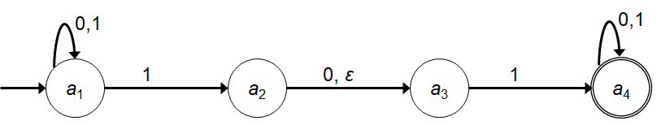
Nondeterministic Finite Automata (NFA)
State Diagram and the Properties of NFA
We already know DFA, so it would be sufficient to look into the differences of properties between the two.
In NFA a state may have –
Zero or more exiting arrows for each alphabet symbol.
Zero or more exiting arrows with the label ε.
So we can see that, not all steps of a computation follows in a unique way from the preceding step. There can be multiple choices to move from one state to another with a symbol. That’s the reason it’s computation is called nondeterministic.

Slide 6
Running an NFA
If we encounter a state with multiple ways to proceed –
The machine splits into multiple copies of itself and follows all the possibilities in parallel.
Each copy of the machine takes one of the possible ways to proceed and continues as before.
If there are subsequent choices, the machine splits again.
If a state with an ε symbol on an exiting arrow is encountered without reading any input, the machine splits into multiple copies,
one following each of the exiting ε-labeled arrows and
one staying in the current state.
If the next input symbol doesn’t appear on any of the arrows exiting the state occupied by a copy of the machine, that copy of the machine dies, along with the branch of the computation associated with it.
If any one of these copies of the machine is in an accept state at the end of the input, the NFA accepts the input strings.
So, nondeterminism may be viewed as a kind of parallel computation wherein several processes can be running concurrently.
If at least one of these processes accepts then the entire computation accepts.

Slide 7
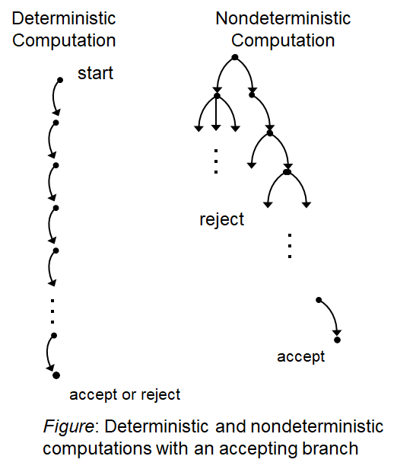
Running an NFA
Another way of viewing a nondeterministic computation is as a tree of possibilities.
The root corresponds to the start of the computation.
Every branching point in the tree corresponds to a point in the computation at which the machine has multiple choices.
The machine accepts if at least one of the computation branches ends in an accept state.
Tree representation

Slide 8
Simulation – NFA Tree
1
0,1
0,
010110
a₁
1
a₂
0,
ε
a₃
1
a₄
Symbol read
0 ----------------------------------------------------------------------------------
1 -----------------------------------------------------------------------
0 ----------------------------------------------------------------
1 ----------------------------------------------------------
1 ------------------------------------------------
0 ------------------------------------------
a₁
a₁
a₁
a₂
a₃
a₁
a₃
a₁
a₂
a₃
a₄
a₁
a₂
a₃
a₄
a₄
a₁
a₃
a₄
a₄
a₄
a₄

Slide 9
Formal Definition of NFA
NFA is a 5-tuple (Q, Σ, δ, q₀, F)
Q is a finite set of states.
Σ is a finite alphabet.
δ : Q × Σ_{ε} → P(Q).
The transition function takes a state and an input symbol or the empty string (Σ_{ε}=Σ ∪ ε) and produces the set of possible next states (P(Q) is the power set of Q).
q₀∈Q is the start state.
F ⊆ Q is the set of accepted states.

Slide 10
Nondeterministic Finite Automata (NFA)
Formal Definition
Let, the above NFA N₁ = (Q₁, Σ, δ₁, a₁, F₁).
Q₁ = {a₁, a₂, a₃, a₄}.
Σ = {0, 1}.
δ₁ | 0 1 ε
a₁ | {a₁} {a₁, a₂} φ
a₂ | {a₃} φ {a₃}
a₃ | φ {a₄} φ
a₄ | {a₄} {a₄} φ
a₁ is the start state.
F₁ = {a₄}.
δ₁ in form δ : Q × Σ_{ε} → P(Q)
δ₁(a₁, 0) = {a₁} δ₁(a₁, 1) = {a₁, a₂} δ₁(a₁, ε) = φ
δ₁(a₂, 0) = {a₃} δ₁(a₂, 1) = φ δ₁(a₂, ε) = {a₃}
δ₁(a₃, 0) = φ δ₁(a₃, 1) = {a₄} δ₁(a₃, ε) = φ
δ₁(a₄, 0) = {a₄} δ₁(a₄, 1) = {a₄} δ₁(a₄, ε) = φ
Q × Σ_{ε} = {(a₁, 0), (a₁, 1), (a₁, ε), (a₂, 0), (a₂, 1), (a₂, ε), (a₃, 0), (a₃, 1), (a₃, ε), (a₄, 0), (a₄, 1), (a₄, ε)}
P(Q) = {φ, {a₁}, {a₂}, {a₃}, {a₄}, {a₁,a₂}, {a₁,a₃}, {a₁,a₄}, {a₂,a₃}, {a₂,a₄}, {a₃,a₄}, {a₁,a₂,a₃}, {a₁,a₂,a₄}, {a₁,a₃,a₄}, {a₂,a₃,a₄}, {a₁,a₂,a₃, a₄}}

Slide 11
Practice NFA

Slide 12
B1 ={w : w is a binary string containing an odd number of 1s}.
B2 ={w : w is a binary string containing an even number of 0s}.
∑ = {0,1}
0
0
1
q1
q2
B1
1
1
1
1
0
q1
0
q2
q3
B2
0

Slide 13
B3 ={w| w ends with a 0}.
B4 ={w| w begins with a 1}.
B5 ={w| w begins with a 1 and ends with a 0}.
∑ = {0,1}
0, 1
q1
0
q2
B3
q1
1
q2
0, 1
B4
0, 1
q1
1
q2
0
q3
B5

Slide 14
B₆ ={w| w has at least two 1s}.
B7 ={w| w has at most two 1s}.
∑ = {0,1}
0
0
0, 1
1
1
B₆
q1
q2
q3
0
0
0
1
1
B7
q1
q2
q3

Slide 15
Closure
A collection of objects is closed under some operation, if applying that operation to the members of the collection returns an object still in the collection.
Theorem: The class of regular languages is closed under all three regular operations (union, concatenation, star), as well as under complement, intersection, and reverse.
i.e., if set A and B are regular, applying any of these operations on these sets yields a regular language.
Next, we will prove it for Union operation.

Slide 16
Regular Language
A language is called a regular language if some finite automaton recognizes it.
Regular Operations: Let A={good, bad}, B = {boy, girl}.
Basic 3 operations used to study the properties of the regular languages –
Union: A∪B = {x : x ∈ A or x ∈ B} = {good, bad, boy, girl}.
Takes all the strings in both A and B and lumps them together into one language.
Concatenation: A • B = {xy : x ∈ A and y ∈ B} = {goodboy, goodgirl, badboy, badgirl}.
Attaches a string from A in front of a string B in all possible ways to get the strings in the new language.
Star: A* = {x₁x₂…x_{k} : k ≥ 0 and each x_{i} ∈ A} = {ε, good, bad, goodgood, goodbad, badgood, badbad, goodgoodgood, goodgoodbad, …}.
Attaching any number of strings in A together to get a string in the new language. It is a unary operation, where ε is always a member of A* (as ‘any number’ also includes 0).

Slide 17
Regular Language closed under Union in dfa
We will prove it by construction.
Let M₁ recognize A₁, where M₁= (Q₁, Σ, δ₁, q₁, F₁), and M₂ recognize A₂, where M₂= (Q₂, Σ, δ₂, q₂, F₂).
Construct M to recognize A₁∪ A₂, where M = (Q, Σ, δ, q₀, F).
Q = {(r₁, r₂) : r₁ ∈ Q₁ and r₂ ∈ Q₂}.
Q = Q₁ × Q₂. (All combination of states of machine M₁ and M₂).
Σ = Σ₁ ∪ Σ₂.
But here, for simplicity, we have considered Σ₁ = Σ₂ to be same.
For each (r₁,r₂) ∈ Q and each a ∈ Σ, let δ((r₁,r₂), a) = (δ(r₁, a), δ(r₂, a)).
Hence δ gets a state of M (which actually is a pair of states from M₁ and M₂), together with an input symbol, and returns M’s next state.
q₀ is the pair (q₁, q₂).
F = { (r₁, r₂) : r₁ ∈ F₁ or r₂ ∈ F₂ }
F = (F₁ × Q₂) ∪ (Q₁ × F₂)

Slide 18
Closure under Concatenation
Let M₁ recognize A₁, where M₁= (Q₁, Σ, δ₁, q₁, F₁), and M₂ recognize A₂, where M₂= (Q₂, Σ, δ₂, q₂, F₂).
Construct M to recognize A_{1°}A₂, where M = (Q, Σ, δ, q₀, F).
M must accept if its input can be broken into two pieces where M₁ accepts the first piece and M₂ accepts the second piece.
Problem: M doesn’t know where to break its input. i.e., where the first part ends and the second begins.
To solve the problem we will learn a new technique called nondeterministic automaton.

Slide 19
Closure Under Regular Operations for nfa
Let,
N₁ = (Q₁, Σ, δ₁, a₁, F₁) recognizes A₁.
N₂ = (Q₂, Σ, δ₂, b₁, F₂) recognizes A₂.
UNION: Construct N = (Q, Σ, δ, q₀, F) to recognize A₁∪ A₂.
Q = {q₀} ∪ Q₁ ∪ Q₂.
q₀ is the starting state.
F = F₁ ∪ F₂.
For any q ∈Q and a ∈Σ_{ε},
N₁
N₂
a₁
b₁
N

q₀

a₁
b₁

Slide 20
Closure Under Regular Operations
Let,
N₁ = (Q₁, Σ, δ₁, a₁, F₁) recognizes A₁.
N₂ = (Q₂, Σ, δ₂, b₁, F₂) recognizes A₂.
CONCATENATION: Construct N = (Q, Σ, δ, q₀, F) to recognize A₁° A₂.
Q = Q₁ ∪ Q₂.
q₀ = a₁.
F = F₂.
For any q ∈Q and a ∈Σ_{ε},
N₁
N₂
a₁
b₁
N

b₁
a₁


Slide 21
Closure Under Regular Operations
Let,
N₁ = (Q₁, Σ, δ₁, a₁, F₁) recognizes A₁.
STAR: Construct N = (Q, Σ, δ, q₀, F) to recognize A₁*.
Q = {q₀} ∪ Q₁.
q₀ is the new start state.
F = {q₀} ∪ F₁.
For any q ∈Q and a ∈Σ_{ε},
N₁
a₁
N
q₀

a₁



Slide 22
B₆ ={w| w has at least two 1s}.
B7 ={w| w has at most two 1s}.
B11 ={w| w has at least two 1s or w has at most two 1s}.
∑ = {0,1}
0
0
0, 1
B₆
1
1
q1
q2
q3
ε
B11
q7
0
0
ε
B7
1
1
q4
q5
q6
0

Slide 23
B₆ ={w| w has at least two 1s}.
B7 ={w| w has at most two 1s}.
B12 ={w| w has at least two 1s followed by w has at most two 1s}.
∑ = {0,1}
0
0
0, 1
B₆
1
1
q1
q2
q3
B12
ε
0
0
B7
1
1
q4
q5
q6
0

Slide 24
B10 ={w| w starts with a 1 and has even length or w starts with a 0 and has odd length}.
Find B10* for ∑ = {0,1}
0, 1
ε
q2
0, 1
q3
1
qs
ε
q1
B10*
0, 1
0
q4
0, 1
q5
ε

Slide 25
Nondeterministic Finite Automata
Introduction to Theory of Computation, Sipser, (3rd ed), NFA.

